Slide 1
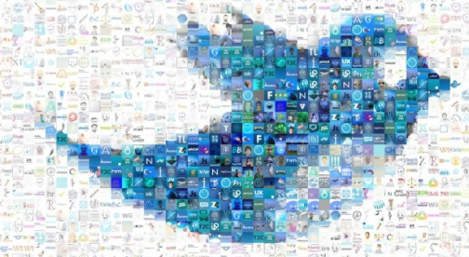
Thinkful Final Capstone NLP: Twitter Sentiment Analysis
Geneson Subra
Feb 2020

Slide 2
Overview
Goal Setting
-Determine the sentiment analysis and scope of work
Data Source
- Twitter API, Tweepy API
- JSON, SQLITE3
Text Processing
- Load Text
- Delete unwanted/ meaningless word
- Sentiment Analysis / text blob / tokenize / sentiment.polarity
Modeling
- Naïve Bayes Classifier
- Text Blob and other modeling
Visualization
- Get geo location for mapping
- Kriging / Interpolation – Spatial interpolation
Final Thoughts and Conclusion
- users geo location
- additional normalization
- experiment with stemming and lemmatization
Next Step
- Web App

Slide 3
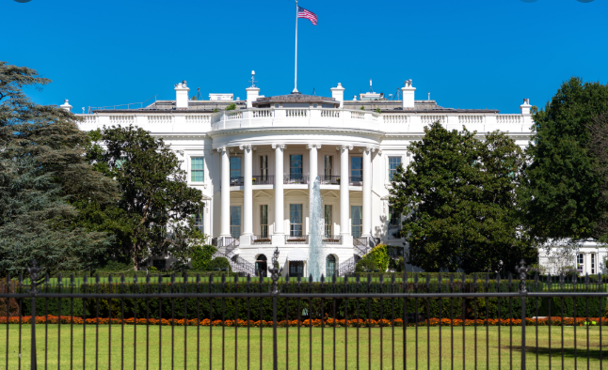
White House

Slide 4
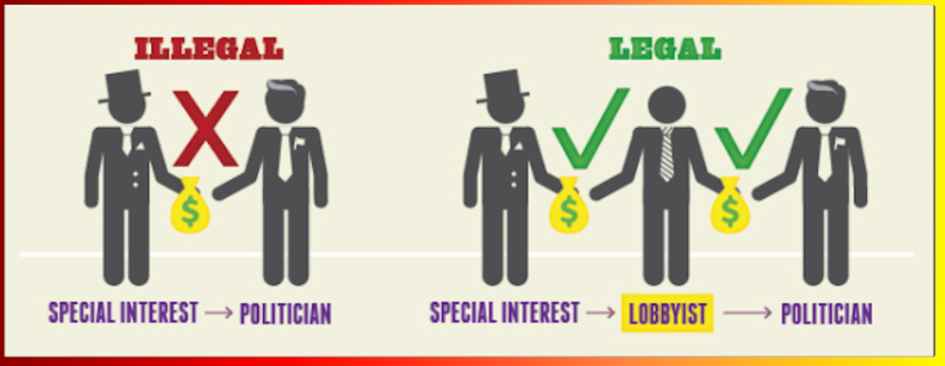
Funding

Slide 5
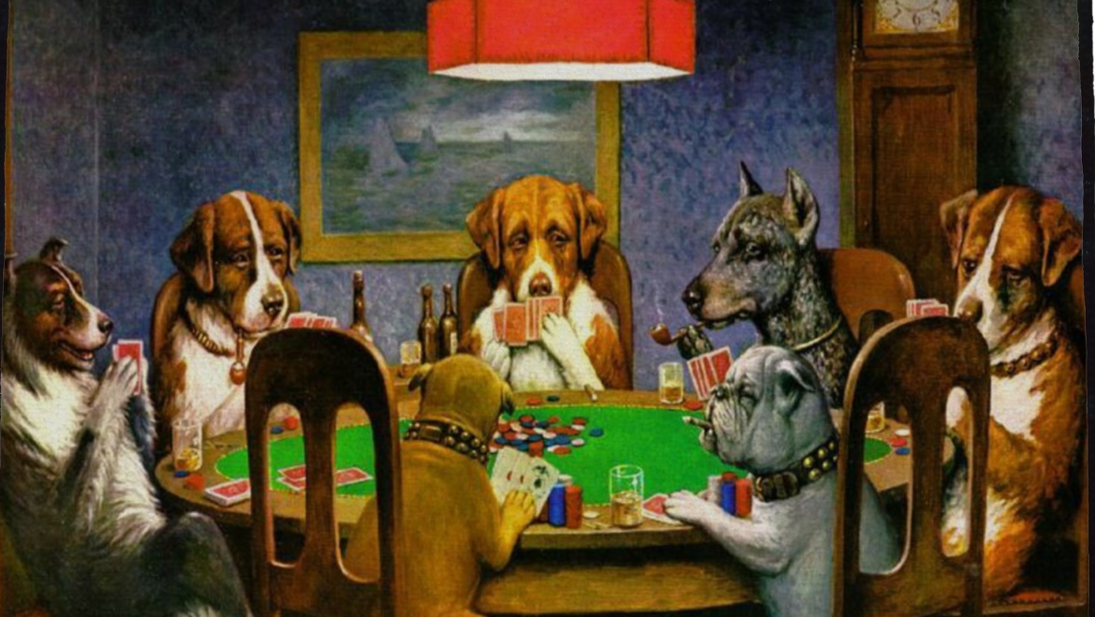
Exploratory Committee

Slide 6
Then What!

Slide 7
Perform market analysis to determine customer sentiment
Politics – Connecting with voters
Product Launch – Consumer Feedback
IPO – favoring the company stock
Decease – preventive measures

Slide 8
consumer_key=‘XXXXXXXXXXXXX', consumer_secret=‘XXXXXXXXXXX’, access_token_key=‘XXXXXXXXXXX’, access_token_secret=‘XXXXXXXXX'
API KEYS
Standard (free ☹)
Premium ($$)
Enterprise ($$)

Slide 9
Data Storage
Storage
● SQLITE3
● JSON

Slide 10
Text pre-processing - clean tweets - remove links - special characters - lowercase

Slide 11
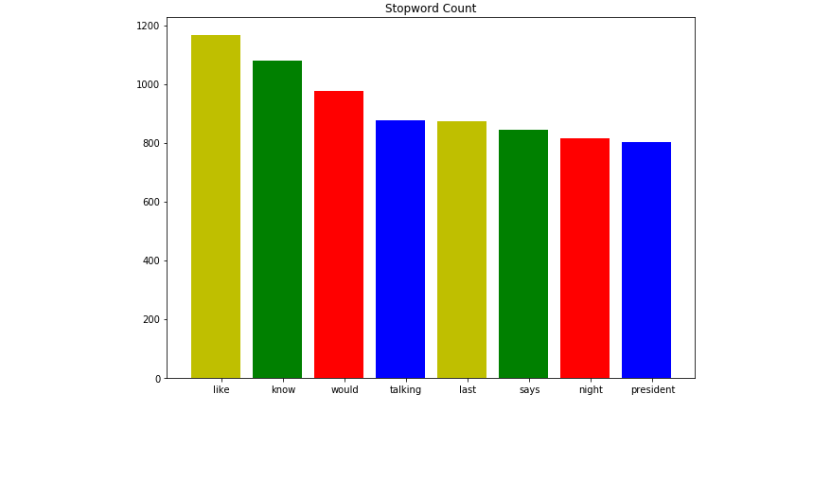
Data Exploration
remove the stop words

Slide 12
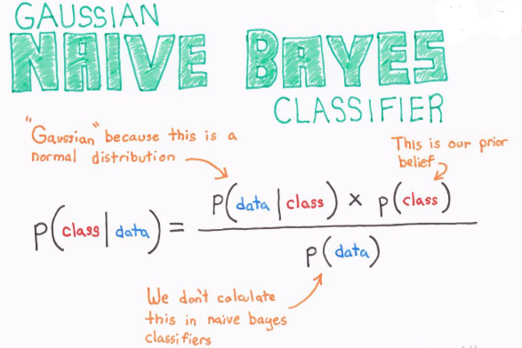
Model Selection
Naïve Bayes
Polarity: Positive & Negative

Slide 13
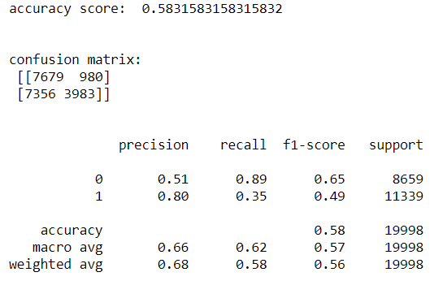
Model Selection
Naïve Bayes
Poor Score!

Slide 14
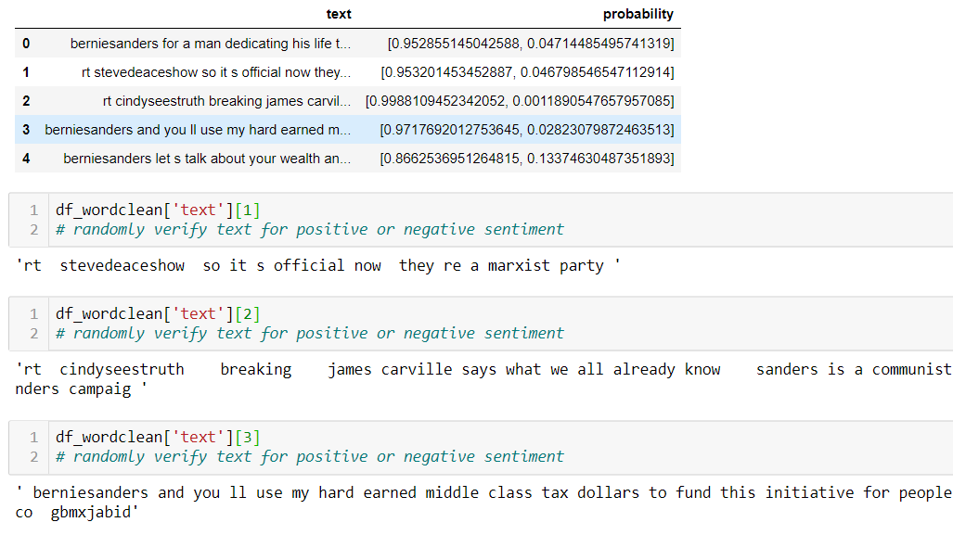

Slide 15
Model SelectioNaive
Naïve Bayes
Naïve Bayes sentiment analysis is off and accuracy is poor!
PlanB

Slide 16
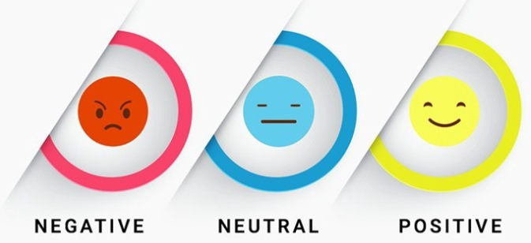
TextBlob
python library and offers a simple API

Slide 17
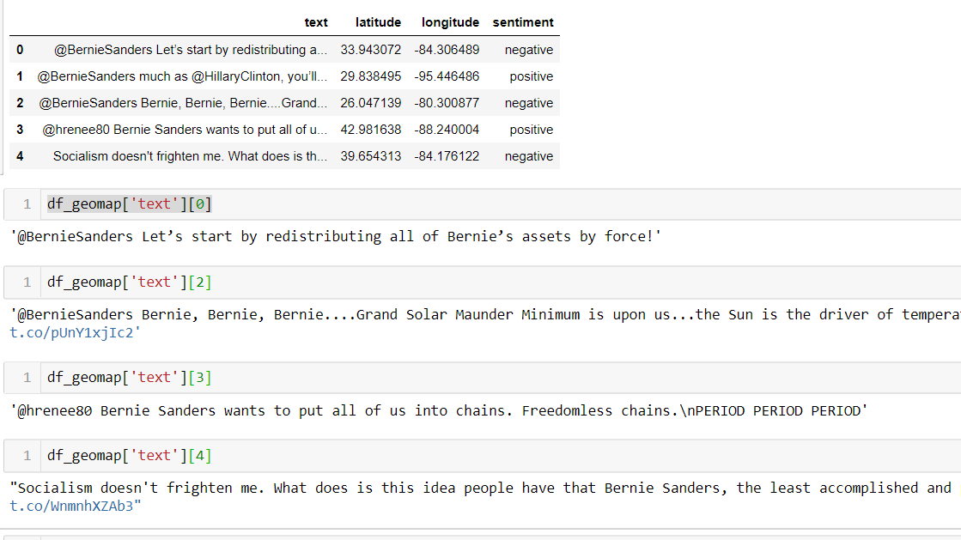

Slide 18
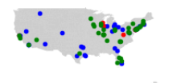
Get the Latitude & Longitude
Plot it with Shapely
Remove Alaska & Hawaii!

Slide 19
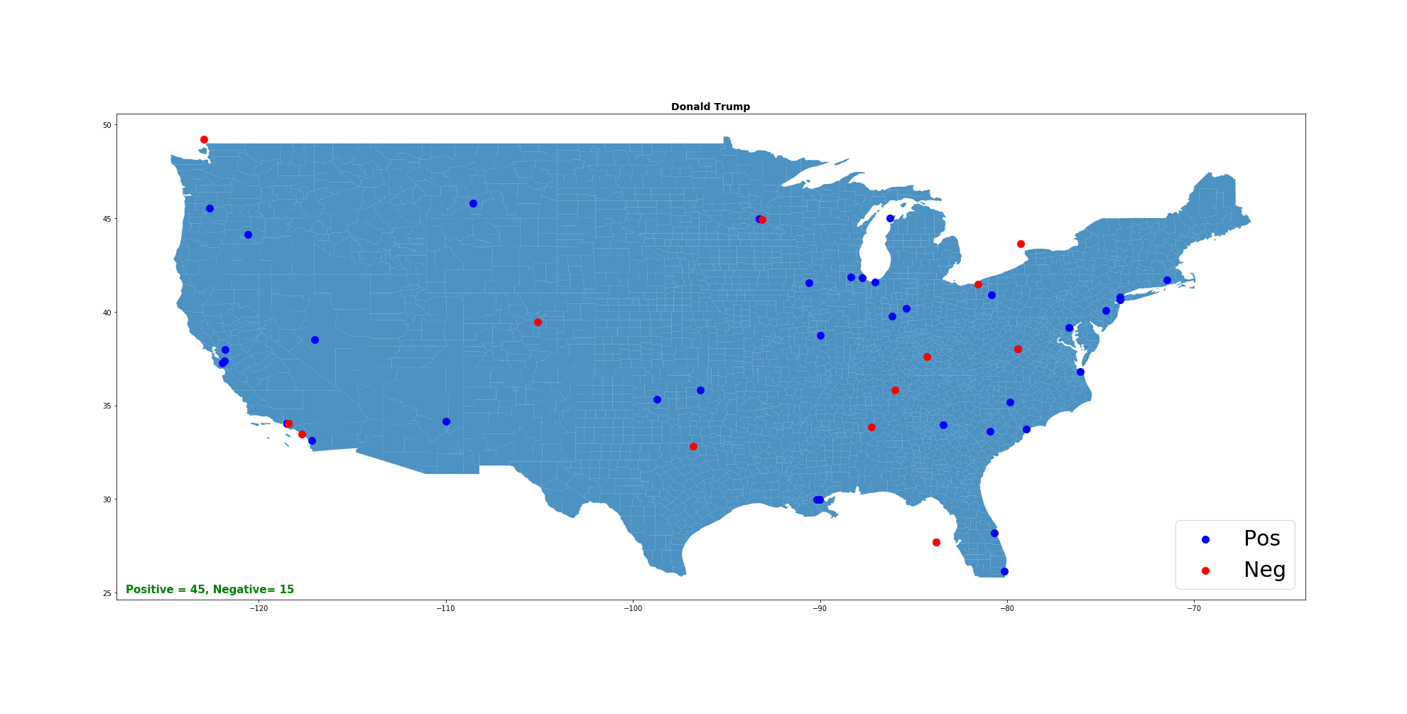

Slide 20
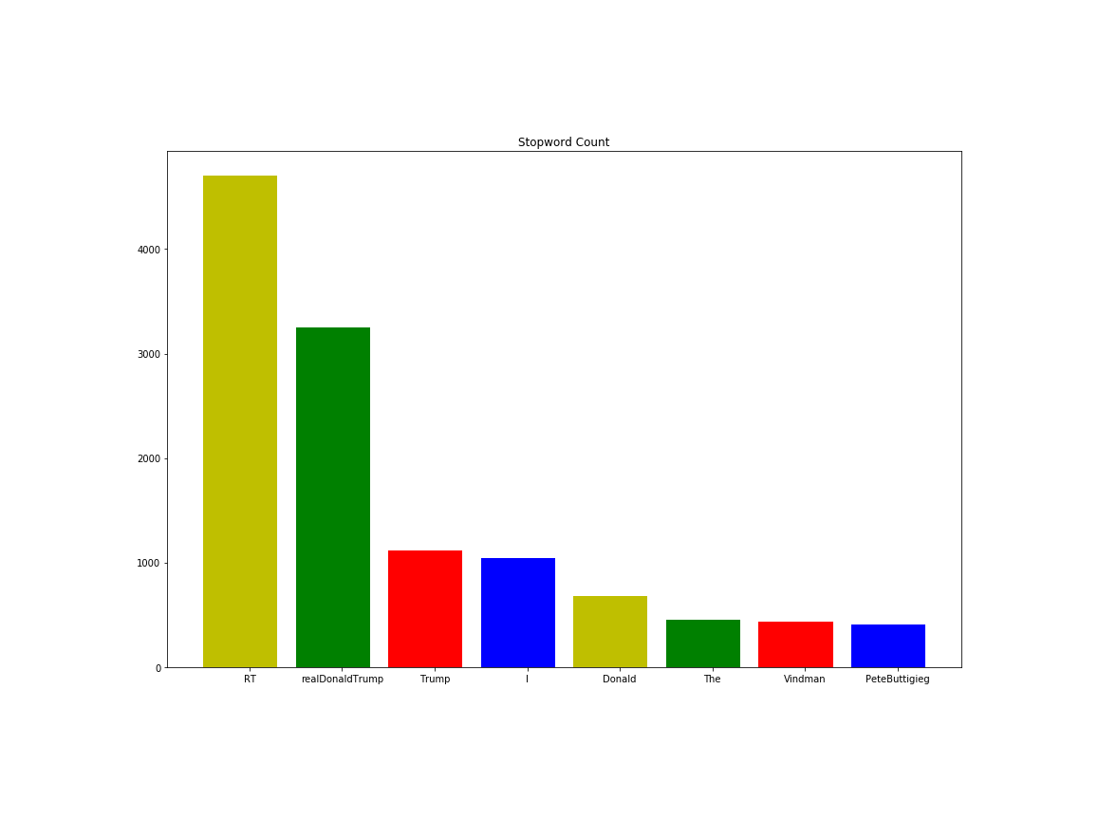

Slide 21
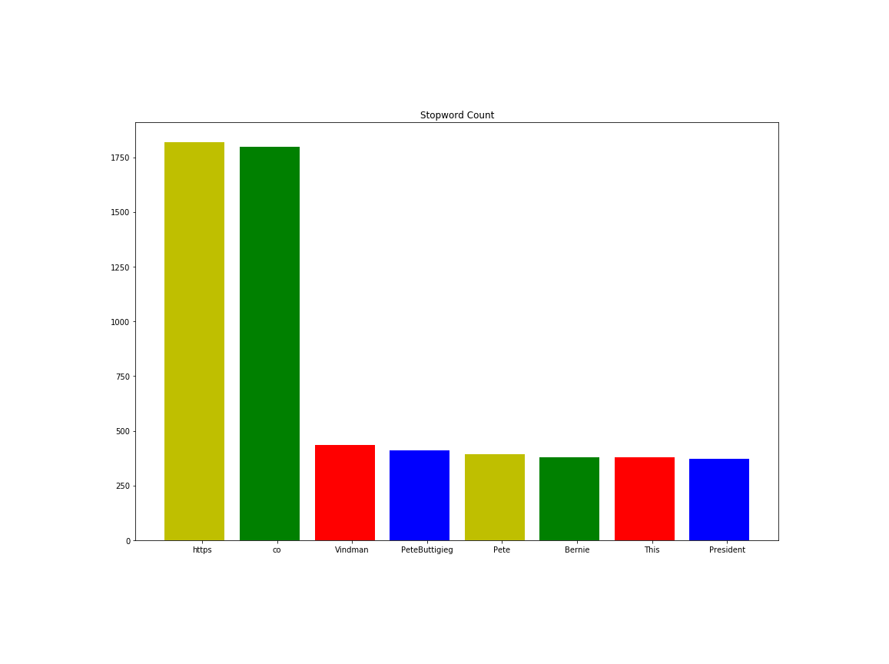
Clean up filler words

Slide 22
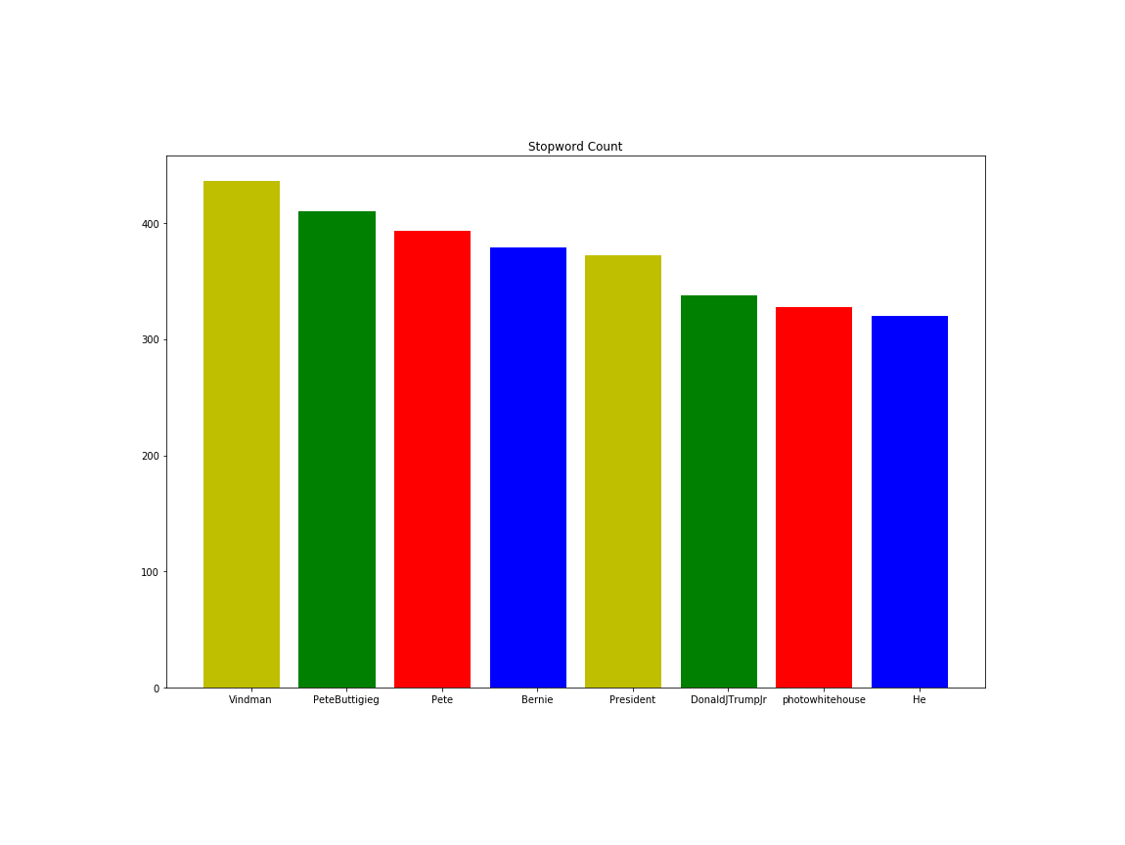
Reduce the stop words

Slide 23

Bernie Sanders

Slide 24
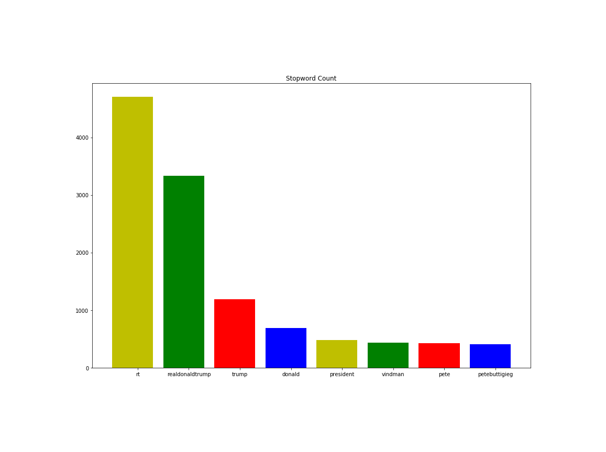

Slide 25
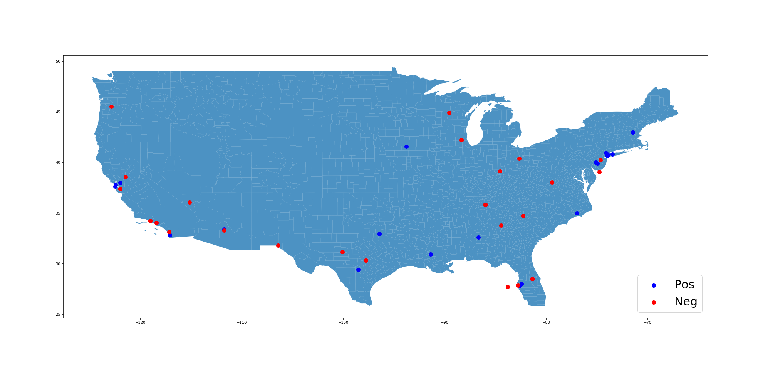
Pete Buttigieg

Slide 26
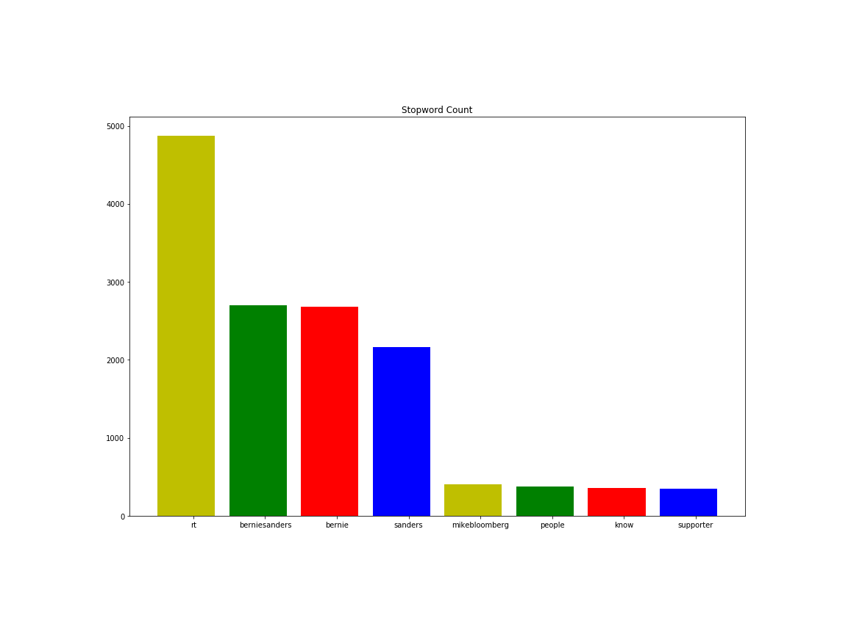

Slide 27
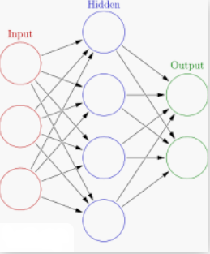
Neural Network
Model

Slide 28
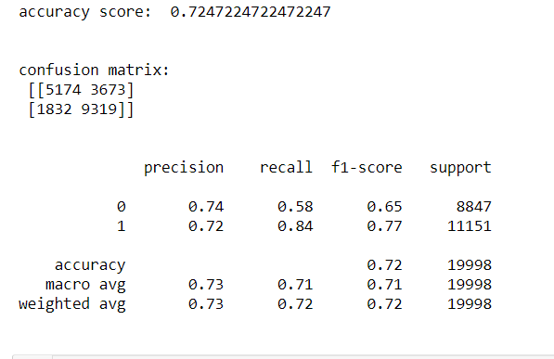
Model Selection
Neural Network

Slide 29
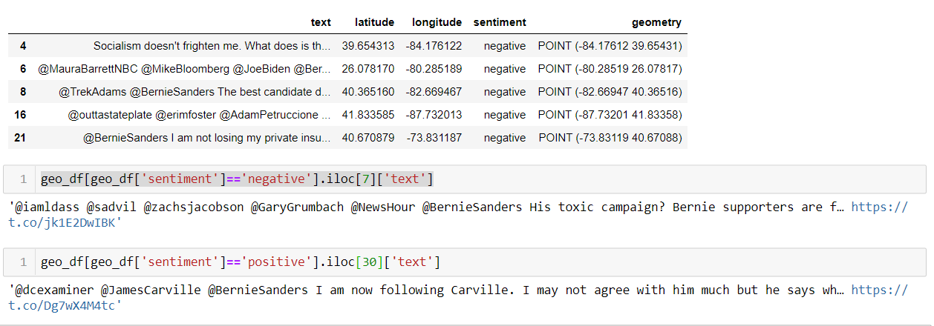

Slide 30

Donald Trump

Slide 31

Donald Trump

Slide 32

Pete Buttigieg

Slide 33
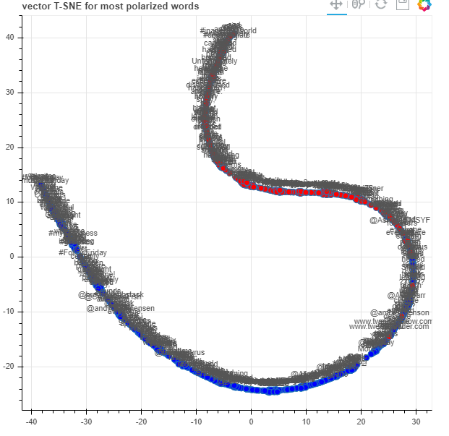

Slide 34
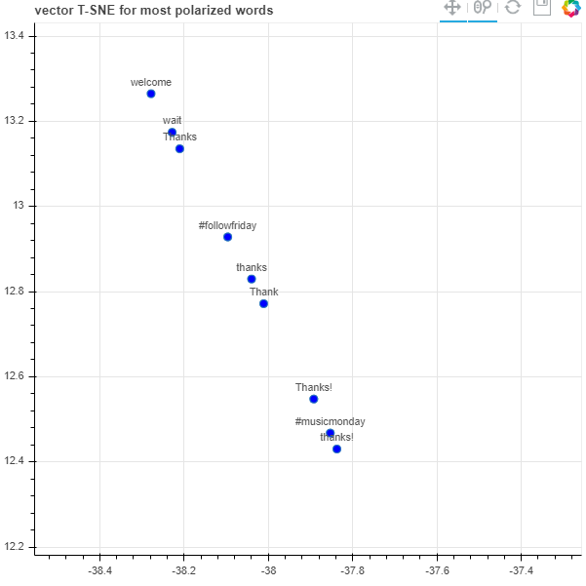

Slide 35
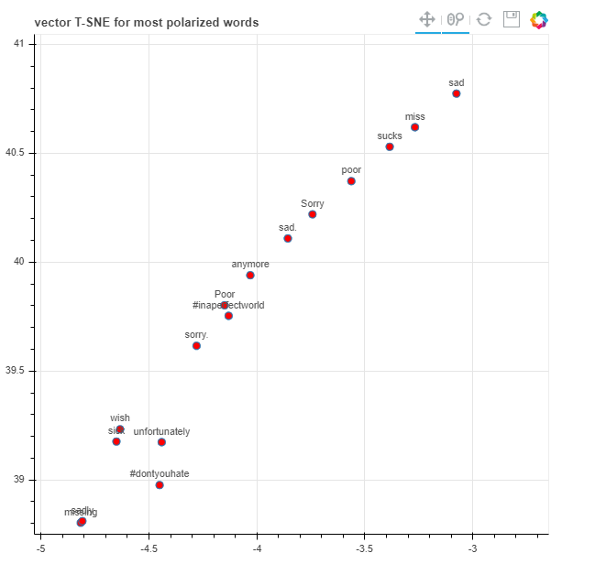

Slide 36
Other Factors: - Sarcasm - Potty words
What ML is good at?

Slide 37
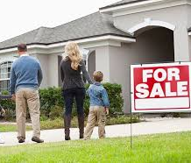


Practical Use
Who can benefit from this predictions
Product Launch – Consumer Feedback
IPO – favoring the company stock
Decease – preventive measures

Slide 38
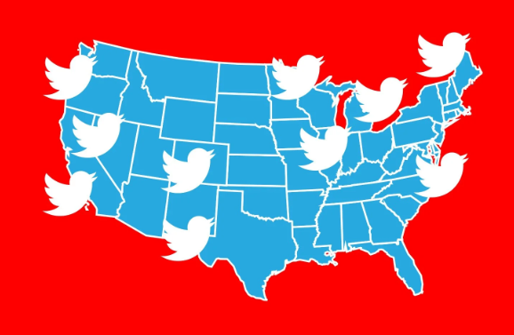
Caution
Geo location enabled

Slide 39
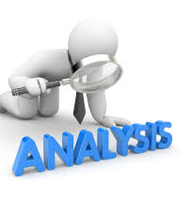
Further Data Analysis:
Use more data to enrich the geo-map
Web Interface

